Slide 1
Phrasal verbs in English songs, or “cultural shock”

Slide 2
Done by
Student Gleb Chekmarev
Form 7
School №24
Research adviser
Lydia K. Yuldasheva
Teacher of English

Slide 3
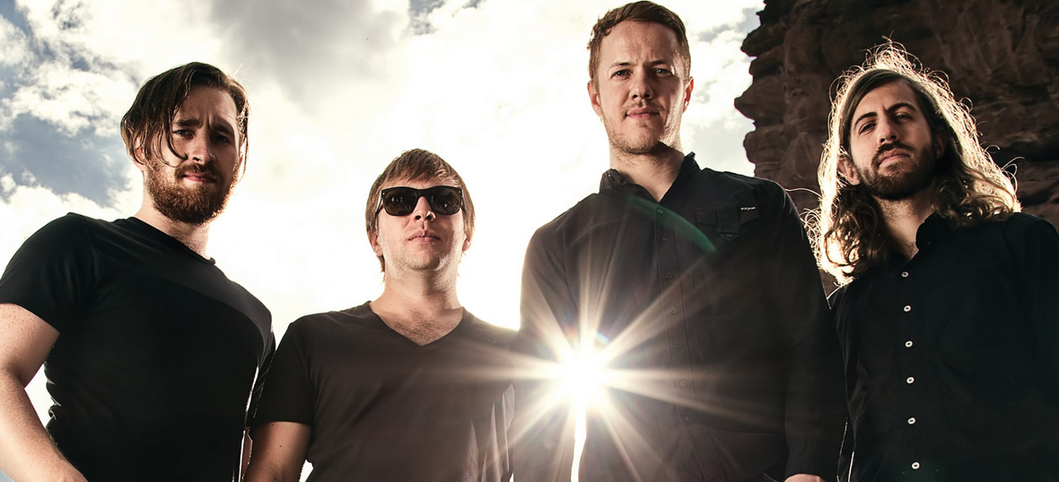
«Imagine Dragons» is my

Slide 4
Hypothesis
Hypothesis of our research is having studied common prepositions we have a chance to understand the meaning of majority phrasal verbs

Slide 5
The goal
The goal of our research is to analyse all the phrasal verbs from 10 songs of «Imagine Dragons».

Slide 6
The tasks are:
To find out what phrasal verbs mean
To analyze the texts of the songs with phrasal verbs
To identify the most used postposition with verbs
To open up the meanings of the postpositions
To do a survey with students of 7th class

Slide 7
Methods of our research
Searching the information
Classification
Analysis
Comparison
Survey

Slide 8
Are there phrasal verbs in Russian?

Slide 9
How many phrasal verbs in English?

Slide 10
Are there phrasal verbs in English songs or their take a part in a casual speech?

Slide 11
Would you like to know more about phrasal verbs?

Slide 12
Thanks for your attention

